Slide 1
NHL Team Comparisions
Telling the story through data visualizations

Slide 2
Project 2 - Team # 3
Sean Carraher
Miguel Gomez
Patricia Johsz
Shyla Samuel

Slide 3

Project Overview
This project will allow the operator to compare professional hockey teams, over the last twenty five years, to determine which team was the better competitor.
The user selects filters on the NHL Comparison dashboard and the application will generate visualizations of the data retrieved and proclaim the winner.
Filter Options:
Display season statistics for a single team.
Compare two teams within a single season.
Compare two seasons for a single hockey organization.

Slide 4
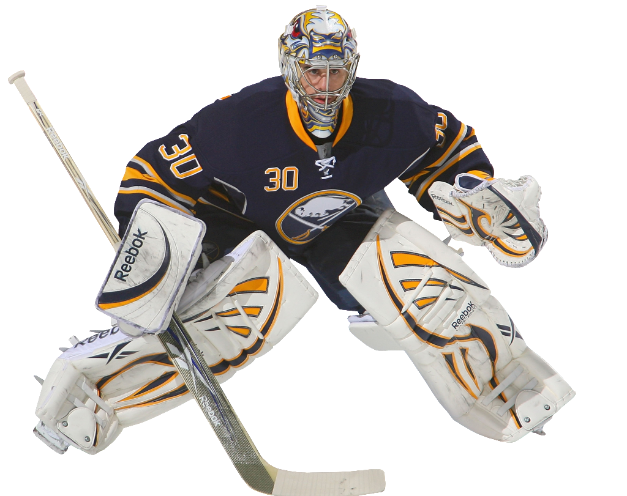
Application Specifications
Multiple visualizations are generated from the same data source.
Drop down filters are dynamically populated from the data store.
The navigation bar allows the user to travel between data views.
Overrides in bootstrap themes and .CSS were utilized to insert pictures in the header and dynamically display team logos.
The flask application is responsive.
Flask SQLAlchemy was used to retrieve data from the repository.

Slide 5

Data storage
Twenty-five (25) years of statistical information was manually extracted from the NHL statistical database and captured as a .csv file.
The data was loaded into a mySQL database.
Views were built from the database to package the information for delivery to the charts.

Slide 6

Java Script Library
The chart.js java script library was selected to build out the visualizations in the application. This library allows the user tell powerful stories with data.
The library is open source and supports 8 different chart types (including bars, lines, & pies), and they’re all responsive.
Chart.js requires changes in the following application files to render charts:
index.html
styles.css
script.js

Slide 7

Application deployment
The Heroku platform (PaaS) was used to deploy and operate the NHL comparison application.
Postgres was enabled to allow for generous resource allocations.

Slide 8


Data Sources
hockey-reference.com
NHL.com

Slide 9
Sprint Demo

